Slide 1

Huffman Encoding Simulator

Slide 2
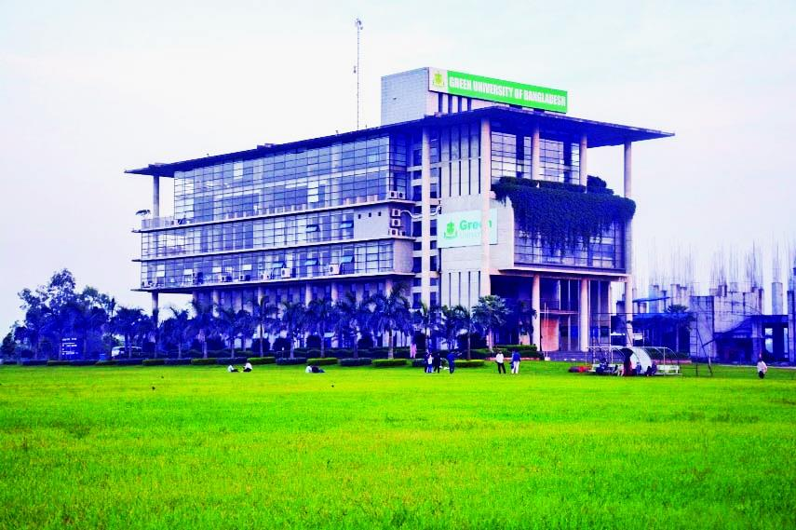





Course Name : Computer Architecture
Course Code: CSE 211 Semester: Spring 2025
Batch: 232 Dept. Of CSE
Presented by,
Presented to,
SYED AHSANUL KABIR
Associate Chairperson
Dept. Of CSE
Green University Of Bangladesh
MD JAMIL HASAN
ID: 212902029
MAJHARUL ISLAM
ID: 232002256

Slide 3
Introduction
Huffman Encoding is a compression algorithm that assigns variable-length codes to characters based on their frequencies.
This project simulates the creation of a Huffman Tree and generates Huffman codes for user input using JavaScript and D3.js for visualization.

Slide 4
Key Features
Interactive input for any message
Responsive and clean UI design
Frequency analysis of characters
Real-time code generation and display
Animated construction of Huffman Tree

Slide 5
Technology Stack
Typing a message as input
Sorting the frequency of the characters
Generating and visualizing the Huffman Tree
Visualizing corresponding Huffman codes

Slide 6
How It Works
1. User inputs a message
5. Huffman Codes are generated and displayed
2. Frequencies of characters are calculated
4. Tree is visualized step-by-step
3. Huffman Tree is built using a priority queue

Slide 7
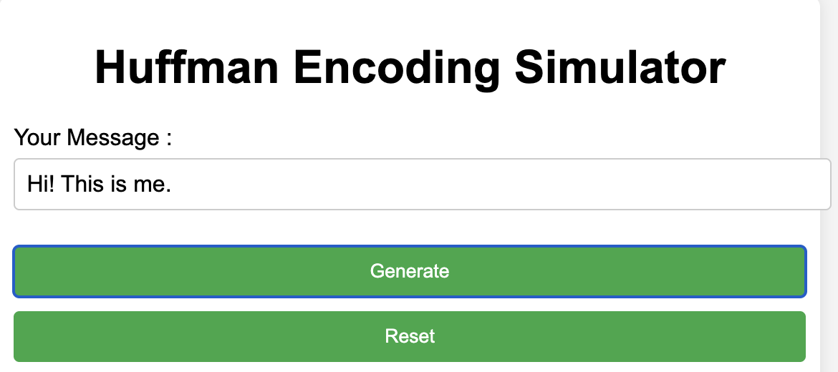
Demonstration

Slide 8
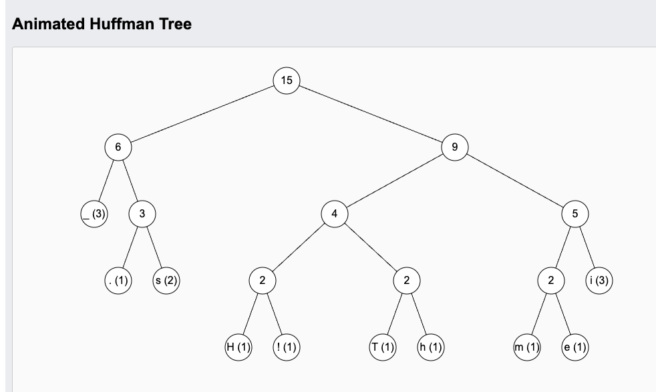
Demonstration

Slide 9
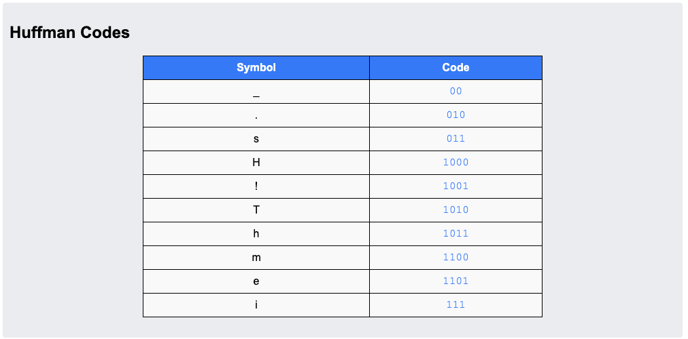
Demonstration

Slide 10
Future improvements:
Export codes to file
Conclusion
Support for larger text
More animations and controls

Slide 11
Thank You
Questions and Feedback !

